Slide 1


Social Buzz Data Analysis

Slide 2


Today's agenda
Project recap
Problem
The Analytics team
Process
Insights
Summary

Slide 3

Project Recap
Social Buzz: Social Buzz is a rapidly growing social marketing platform on a global scale.
Audit of Social Buzz big data Practice.
Recommendation of successful IPO.
Analysis to find top 5 most Popular categories of content.
Understand or extracting insights of the massive amount of unstructured data.

Slide 4


Problem
Every day over 100000 pieces of content posts.
Over 500 million users reached in each month.
Over 15 ways reactions of contents.
Very hard to massive data unstructured data
More than 10 reactions have for a sentiment

Slide 5



Andrew Fleming
(Chief Technical Architect)
The Analytics team
Marcus Rampton
(Senior Principle)
Madhavi Soni
(Data Analyst)

Slide 6
Process
1
Data Understanding
2
Data Cleaning
3
Data Modelling
4
Data Analysis
5
Uncover Insights

Slide 7

Insights
The data represents social buzz in various categories. Analyzing the total scores for each category, we can observe the
following insights:
Popular Categories: Categories like Animals, Healthy Eating, and Science have high total scores, indicating significant engagement and interest in these topics.
Lower Engagement Categories: Categories like Studying, Dogs, Public Speaking have relatively lower total scores, indicating comparatively less engagement or interest in these topics.
To determine the impact of positive, neutral, and negative reactions in each category, we can analyze the sentiment scores and their corresponding categories in the provided data so most of impact of positive reactions in each categories.
distribution of score highest Photo content.
The month of August had the highest distribution of contents in 2020, while the month of May had the highest distribution of contents in 2021.
5. most significant positive reactions
UNIQUE CATEGORY
16
TOTAL CONTENT DISTRIBUTION
2457.K
PEAK CATEGORY
ANIMAL
74965

Slide 8
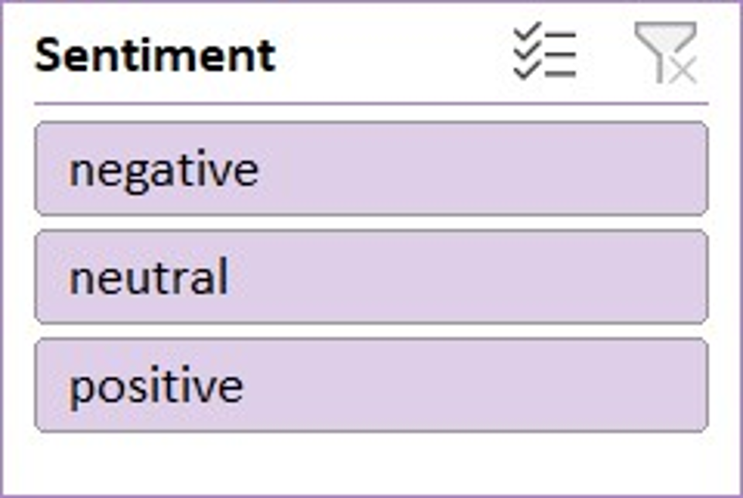
SOCIAL BUZZ DATA ANALYSIS DASHBOARD

Slide 9
Summary
Insights for Effective Content Creation :
Identify top categories and content type with the highest score
Prioritize content creation efforts based on popularity improve
Audience engagement by focusing on high- performing content.
Optimizing Content Posting Schedule :
Analyze content posting frequency identify patterns and variations
In posting schedule optimize posting schedule for consistent and
Engaging content.
Analyze Content Maximum user Engagement :
Understand the distribution of user reaction customize content to resonate with the audience maximum user engagement and positive reaction .
4. Impact of Reactions:
By analyzing sentiment scores, the project aimed to determine the impact of positive, neutral, and negative reactions within each category. This analysis helped identify the categories with the most significant positive reactions.
5. Content Strategy With Visualizations :
Line Chart : The line chart will illustrate the distribution of content over time. It will show how the volume of content changes across different months or time intervals. This visualization will help identify trends, spikes, or dips in content production, allowing users to understand the patterns of content creation.
doughnut chart :
It provides a clear overview of the score distribution and It helps viewers understand how the scores are distributed across different content and make comparisons between the content visually apparent.
The distribution of scores indicated that photo content had the highest engagement or impact among the various content types.
Scatter Column Chart :
This visualization will allow viewers to compare the impact of reactions for each category and observe the distribution of sentiments within each category. It provides a clear overview of the sentiment distribution and allows for easy identification of categories with a dominant sentiment or variations in sentiment impact across different categories.
The project provided valuable insights for effective content creation by identifying popular categories, understanding audience engagement through sentiment analysis, and highlighting the impact of different content types and timing. These insights can guide content creators in prioritizing their efforts and maximizing audience engagement in future content creation strategies.

Slide 10

Thank you!
ANY QUESTIONS?

